Slide 1
Network Security
Assignment 2
Herschelle Gupta 2019045
Ritik Vatsal 2019321

Slide 2
Project 0
Implementing the encryption & decryption of a 64-bit plaintext using DES. And, using the system created -
a. Verifying that the ciphertext when decrypted will yield the original plaintext,
b. Verifying that output of the 1st encryption round is same as output of the 15th decryption round
c. Verifying that output of the 14th encryption round is same as the output of the 2nd decryption round

Slide 3
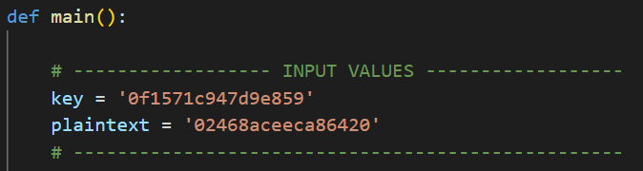
Input
Inputs to the system are plaintext and key inside the ‘main’ function. They should be a 64-bit value in hexadecimal format.

Slide 4
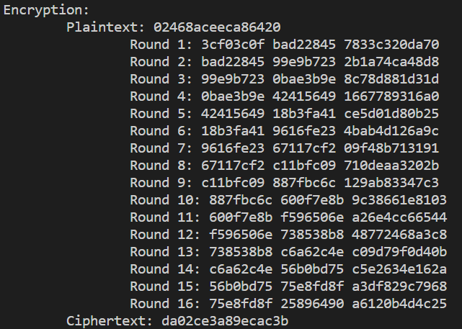
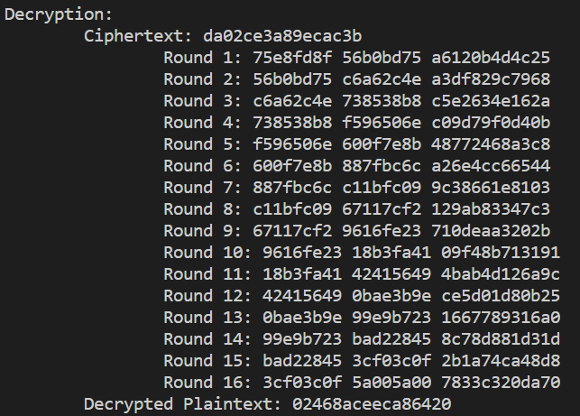
Output
Upon running the code, it prints <Li, Ri, Ki> generated for all 16 rounds for both encryption and decryption in hexadecimal format.

Slide 5
Verifications - 1
Plaintext - “02468aceeca86420”

Slide 6
Verifications - 1
Input of encryption is the same as output of decryption

Slide 7
Verifications - 1
B) Output of 1st encryption round is same as output of the 15th decryption round. Encryption<L1> = Decryption <R15> & Encryption<R1> = Decryption <L15>

Slide 8
Verifications - 1
C) Output of 14th encryption round is same as output of the 2nd decryption round. Encryption<L14> = Decryption <R2> & Encryption<R14> = Decryption <L2>

Slide 9
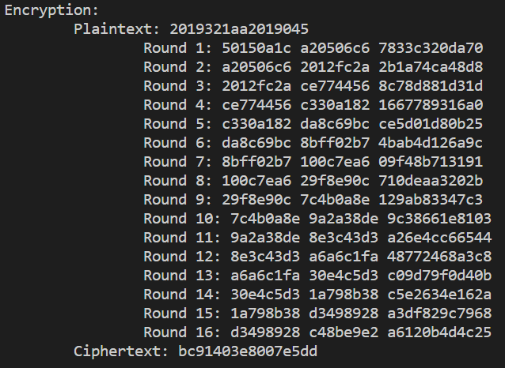
Verifications - 2
Plaintext - “2019321aa2019045”

Slide 10
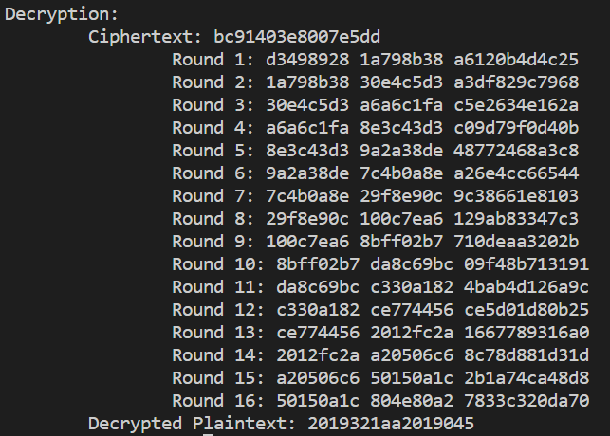
Verifications - 2
Input of encryption is the same as output of decryption

Slide 11
Verifications - 2
B) Output of 1st encryption round is same as output of the 15th decryption round. Encryption<L1> = Decryption <R15> & Encryption<R1> = Decryption <L15>

Slide 12
Verifications - 2
C) Output of 14th encryption round is same as output of the 2nd decryption round. Encryption<L14> = Decryption <R2> & Encryption<R14> = Decryption <L2>

Slide 13
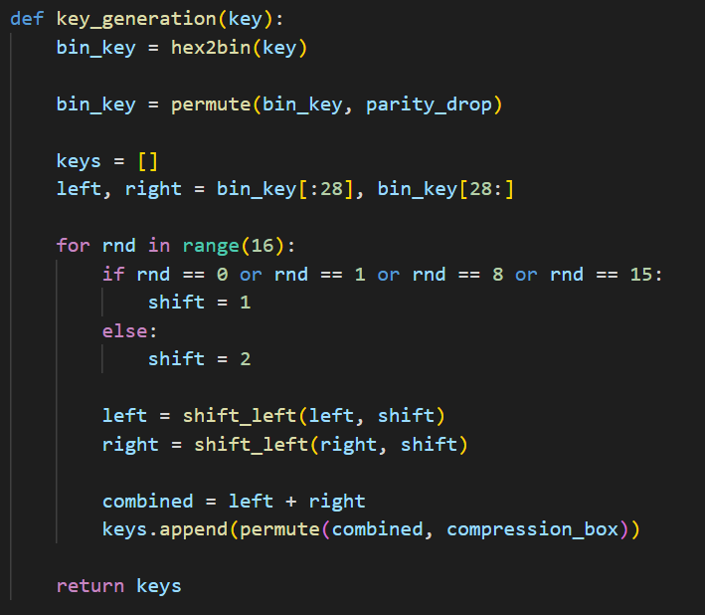
Algorithm - Key Generation
Convert key from hex to bin
Pass through parity drop box
Divide key into 2 equal halves
Perform 16 Rounds which include
left shifts
compression box

Slide 14
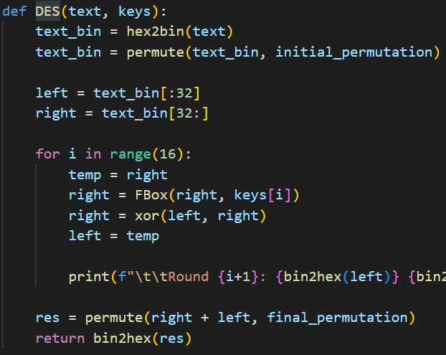
DES Algorithm
Convert text from hex to bin
Perform initial permutation
Divide into 2 equal halves
Perform 16 rounds which include
Pass right half through F Box
Xor right and left halves
Left becomes initial right
Perform final permutation (which is inverse of initial permutation)

Slide 15
Thank You!

